Slide 1
Citrix & Microsoft:
Partner to Win in Virtualization
Notes:
1

Slide 2
Agenda
Citrix & Microsoft Technology
Desktop Virtualization Vision
Citrix XenDesktop 4.0 & Microsoft VDI Suite
CMVP

Slide 3
Citrix & Microsoft Partnership
Product Alignment

Slide 4
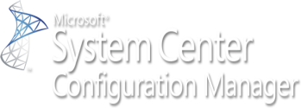
Citrix Enterprise Solutions on Microsoft Platform
Desktops
Applications
Networks
Servers
Citrix Enterprise Solutions
NetScaler
XenDesktop
XenApp
Essentials for Hyper-V
Branch Repeater Windows Server
Microsoft Platforms

Slide 5
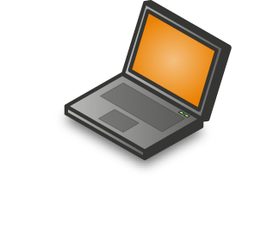
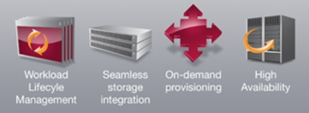
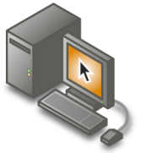
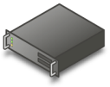
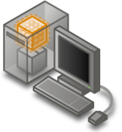
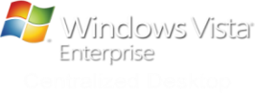
Microsoft Virtualization with Citrix
XA/XD Profile Management
User State
Virtualization
Folder Redirection
Offline files
Citrix Essentials for Hyper-V
Citrix XenApp 5.0
Presentation Virtualization
Server Virtualization
R2
Desktop Virtualization
Application Virtualization
Citrix XenApp 5.0
Citrix XenDesktop

Slide 6
Desktop Virtualization Vision

Slide 7
Redefine the Desktop
Device + OS + Apps + Profile
OS
Applications
User data,
settings

Slide 8
Tightly Coupled & Locally Installed
Traditional Management Tools & Processes
User
1. Procure
8. Retire
Profile
Deploy
2. Image
7. Back-up
Apps
Desktop OS
3. Secure
6. Maintain
Client
4. Deploy
5. Monitor

Slide 9
Tightly Coupled & Locally Installed
Centralized single inTraditional Management Tools & Processes
stance images
User
1. Procure
8. Retire
User Profile
Profile
2. Image
7. Back-up
Apps
Apps
Desktop OS
3. Secure
6. Maintain
Desktop OS
Client
4. Deploy
5. Monitor

Slide 10
Virtualized & Isolated Desktop Components
User
User
User Profile
User Profile
Profile
Apps
Apps
Apps
Desktop OS
Desktop OS
Desktop OS
Client
Client

Slide 11
Virtualized & Isolated End-point Components
Tightly Coupled & Locally Installed
Local or Hosted
User
User Profile
Profile Virtualization
On-demand assembly &
delivery
Profile
App Virtualization
Apps
Apps
Desktop Virtualization
Desktop OS
Desktop OS
Client

Slide 12
Dependencies Create Complexity
Separation Creates Flexibility
Folder Redirection
Roaming Profiles
Group Policies
Data, User settings
Applications
App-V
Remote Apps
MEDV
App
App
OS
XP
Vista
Windows 7
Hardware
Thin
Desktop
Mobile
Separating desktop components -
Desktop Virtualization is the enabler

Slide 13
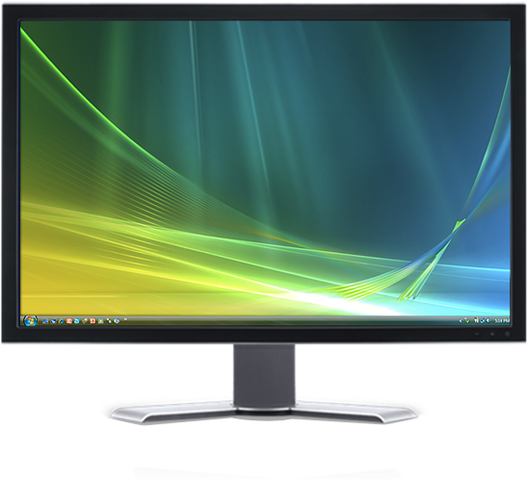
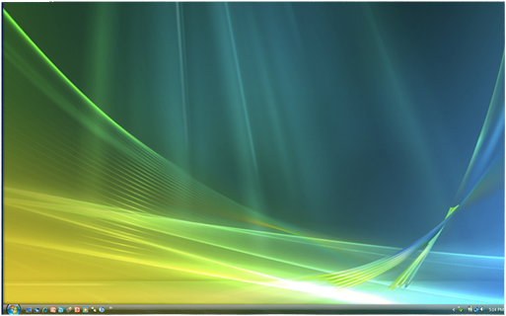
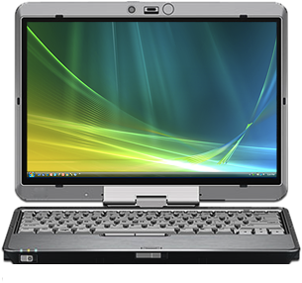
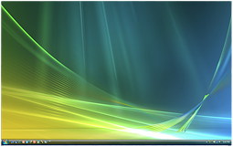
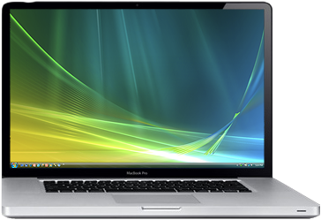
Desktops & Apps as a Service

Slide 14
One
Vision
One image of apps & desktops
One password & identity
One instance of data
One user experience – anywhere

Slide 15
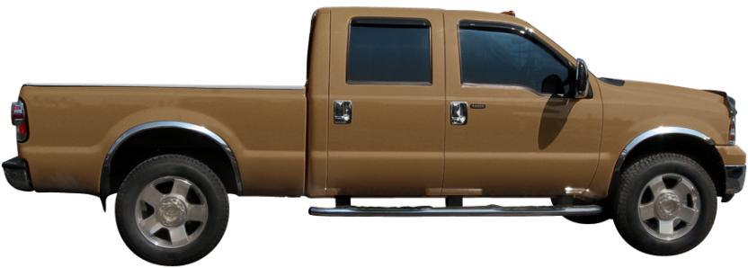
Other VDI Products Merely Bolt On To Server Virtualization
VDI
Server virtualization

Slide 16
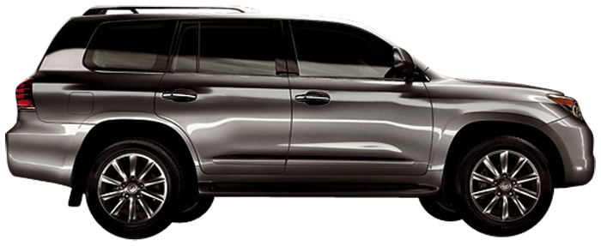
Purpose Built Desktop Virtualization & VDI
XenDesktop 4
The virtual desktop revolution is here… for everyone

Slide 17
Citrix XenDesktop 4 & Microsoft VDI Suite

Slide 18
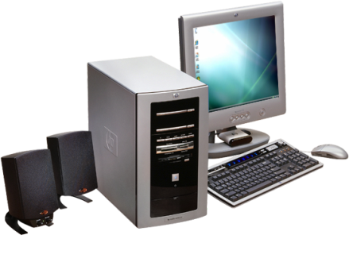
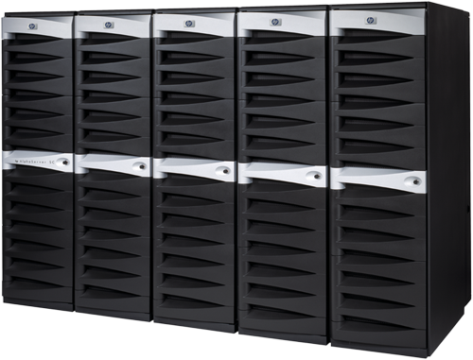
What is Virtual Desktop Infrastructure (VDI)?
Virtual Desktop Infrastructure (or VDI) is an architectural model where a client OS runs in a server-based virtual machine environment and interacts with the user via a network connection.
The storage and execution of a desktop workload (OS, apps, data) is centralized on a virtual machine in the datacenter
Presentation of the UI is managed via a remote desktop protocol (such as RDP or ICA) to client devices
Desktop Workload
(OS, Apps, Data)

Slide 19
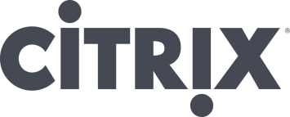
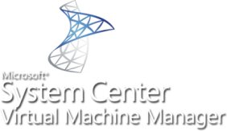
Microsoft-Citrix VDI Solution
Citrix is Microsoft’s joint go-to-market partner for VDI
Joint Microsoft-Citrix VDI Stack
Application Delivery Options
for Integrated
Management
Remote App
XenApp
XenApp
Desktop Delivery
XenDesktop
Essentials for
Hyper-V
Windows VECD

Slide 20
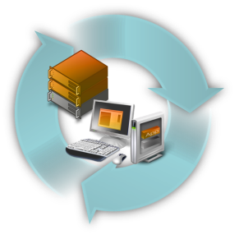
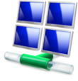
Microsoft-Citrix VDI
Best Remote User Experience
Integrated
Management
Most Comprehensive & Cost Effective Offering
The Best Remote Experience
Single console for physical, virtual and session based desktops
Lowest infrastructure costs amongst competitive VDI
Excellent performance on LAN and WAN
Heterogeneous Infrastructure management
Reduced storage costs
Familiar Platform
Built on Windows Server Operating System
Leverage Existing Tools & Skills

Slide 21
Hi-def user experience
Best desktop for every user - More than VDI
On-demand apps
Any device, anytime, anywhere
Open architecture
XenDesktop 4
Notes:
Broadest device support: Desktop appliance (windows, linux), Repurposed PC (windows, linux), Home PC, Macintosh, Netbook
Any hypervisor
All 5 Delivery Models
Got to be 5 and not 6 strategic features
Where does OD apps sit?
Any hypervisor
Single instance management / model / architecture
Option/method
Multi-XYZ delivery architecture
Mode;
On demand versus self-service

Slide 22
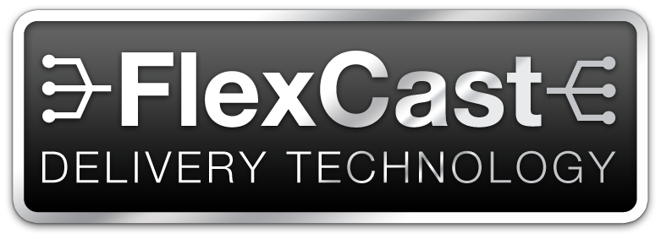
Full Flexibility to Deliver All Types of Virtual Desktops
Any user any device
Any type of virtual desktop
One centrally managed solution

Slide 23
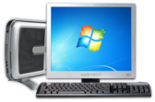
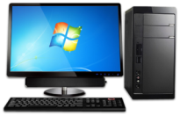
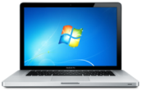
Citrix XenDesktop 4 – FlexCast™ delivery technology Hosted desktop delivery models
400-500 users per server
hosted shared
desktop
50-60 VMs per server
VM
VM
VM
VM
1 user per Blade PC
Blade PC
Blade PC

Slide 24
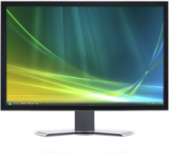
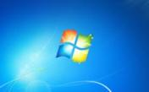
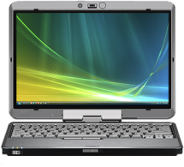
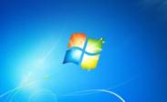
Citrix XenDesktop 4 – FlexCast™ delivery Local desktop & application delivery models
Local Streamed Desktops (online)
XenDesktop 4
USER PROFILE
APPS
OS
Virtual Apps to Installed Desktops (online and offline)

Slide 25
Best Remote User Experience
Integrated
Management
Most Comprehensive & Cost Effective Offering
On Demand App Deilvery
Proven, enterprise scalability
Granular access control
App delivery to physical & virtual desktops
Self-service enterprise app store
On-demand apps by XenApp™
& App-V

Slide 26
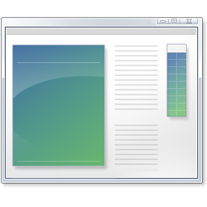
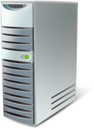
App-V with XenDesktop
App-V helps eliminate conflicts between applications and removes the need to install those applications on PCs
Improves Application Compatibility
prevents one app conflicting with another
Prevents one app conflicting with other instances of itself
Fixes many issues where app wouldn’t run as standard user
Enables Consolidation of Session Hosts
No longer any need for silos of session hosts
Allows session hosts to be homogenous
Improves user profiles
Application settings can be stored to network location / roamed independently
Increases usefulness of mandatory profiles

Slide 27
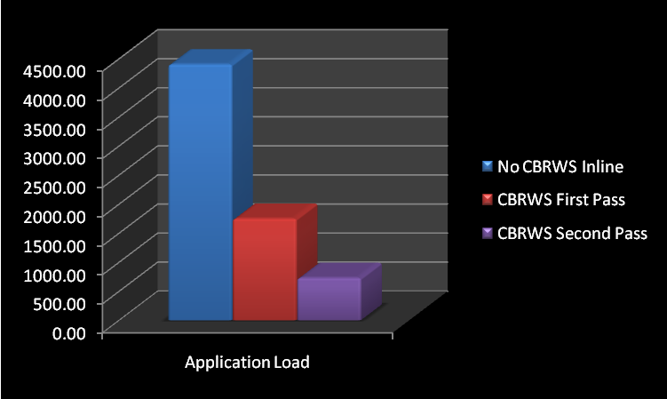
XenDesktop extends the reach of App-V
XenApp policies applied to App-V apps
HDX experience for hosted App-V apps
Deliver App-V apps to non-Windows devices
Delivers App-V to branch offices
Self-Service delivery of App-V apps

Slide 28
HDX
Rich multimedia
Real-time collaboration
USB plug-n-play
3D graphics applications
Best network performance
Branch office optimization
user experience

Slide 29
Plug-n-Play with Microsoft infrastructure
Single Image Management
Any storage platform
App-V fallback/failover
Granular Access for App-V
App-V access to non-windows devices
XD 4.0
Additional Benefits

Slide 30
At-a-Glance: XenDesktop 4 Enhancements
Category | Feature | Remarks
HDX MediaStream | Flash redirection | Win32, low latency (max 30ms RTL)
 | Audio optimization | New codecs to optimize bandwidth for high quality audio
 | Media Foundation support for Windows Media Player | For WMP on Win7 and Vista
 | Dynamic frame rate tuning | Adjust fps for server-rendered video (up to 30 fps) based on available bandwidth
HDX Plug-n-Play | Flexible multi-monitor support | L-, U- and T-shaped monitor configurations, different sizes and resolutions; Basic multi-monitor support on desktop appliance and non-windows client; Advanced on Windows PC using connection bar
 | SmartCard enhancements | Vista and Win7 VDA support Streamlined logoff
 | Enhanced USB support / webcams | Isochronous USB (Win32, LAN)
HDX RealTime | Webcams | Isochronous USB (see HDX Plug-n-Play above) Support for Flash-based video conferencing (see Flash above)
 | Audio optimization | (see HDX MediaStream)

Slide 31
At-a-Glance: XenDesktop 4 Enhancements
Category | Feature | Remarks
HDX Broadcast | ICA enhancements | Improvements in user experience during logon, using hosted apps etc.
VDA OS support | 64-bit | Windows 7 64-bit Windows XP 64-bit SP3 Windows Vista 64-bit SP2
HDX IntelliCache | Citrix Repeater integration | Optimize ICA traffic to branch offices; Similar to ICA optimization for XenApp users
Provisioning services | Standard Image Mode NIC Teaming | Ability to use NIC Teaming drivers from Broadcom and Intel to setup NIC "teams" on PVS clients
 | Offline vDisk Maintenance | Ability to boot PVS VHD files directly within Windows Virtual Server and Hyper-V
 | User Assigned Virtual Disks | vDisks are assigned to groups rather than machines
 | Offline Database Support | Ability for PVS to continue to be able to boot and run clients even when the DB is unavailable.

Slide 32
At-a-Glance: XenDesktop 4 Enhancements
Category | Feature | Remarks
Provisioning services, continued | Multiple Partition vDisks | Ability to create vDisks that include multiple partitions (e.g. both a C: and D: drive)
 | Server Maintenance Mode | Ability to initiate failover of all clients attached to a particular PVS server to the other servers in the PVS farm
Service monitoring and reporting | Performance monitoring | End-user experience metrics Admin & operational reports
Site roaming | User roaming support | Thin client user can connect to his XenDesktop and data regardless of the site from which he is connecting
Site failover | Redirect users to an alternate datacenter | Failover site for users in case primary site fails
Alternate protocols | RDP support and SDK for alternate protocols | Enables users on a device where they can’t install the Citrix Receiver to access their virtual desktop using RDP and simplifies migration to XenDesktop from other desktop virtualization solutions
Single sign-on | Citrix Password Manager | Tested with CPM 4.6 SP1

Slide 33
Best Remote User Experience
Integrated
Management
Most Comprehensive & Cost Effective Offering
"best of breed"
"gold standard"
"a clear winner"

Slide 34
With Citrix XenDesktop we were able to fulfill user requirements… the performance of the virtualized desktop is comparable to that of a locally installed desktop.
Patrick Kaeslin
Head of Front End Engineering
Swisscom IT Services AG
Notes:
http://virtualizationreview.com/features/article.aspx?editorialsid=2599

Slide 35
We could roll out mobile units extremely quickly, and officers were comfortable using them immediately… increasing the visibility of police on the streets and the productivity of its police officers by 30 per cent.
“Leicestershire Constabulary puts bobbies back on beat,”
James Pearce
Information systems analyst
Case study by ITPro
Notes:
http://virtualizationreview.com/features/article.aspx?editorialsid=2599

Slide 36
With XenDesktop, we can ensure that developers are able to operate their virtual Windows XP desktop, including all applications, as smoothly as their locally installed user environment—irrespective of the geographic distance to be covered… We are already able to talk about a successful business case.
Klaus Stein
Lead Project Manager,
Telefónica O² Germany GmbH & Co. OHG
Notes:
http://virtualizationreview.com/features/article.aspx?editorialsid=2599

Slide 37
“XenDesktop is a perfect fit…the look and feel on the desktop has not changed; there is no need to upgrade expensive network connections; and we are able to add new applications by adjusting the golden image.”
Danny de Vries
Application Delivery Specialist, IVENT
For Netherlands Ministry of Defence
Notes:
http://virtualizationreview.com/features/article.aspx?editorialsid=2599

Slide 38
VMware View on User Experience
Poor experience for WAN users
Slow screen refresh
Slow mouse/keyboard response
Latency critical
High bandwidth requirements
10X more bandwidth for Flash
3.6X more bandwidth for Office
PCoIP more bandwidth intensive
3rd party protocols insufficient
Many require proprietary hardware
Significant extra cost
See comparison videos @ http://www.youtube.com/user/Desktop2020Blog

Slide 39
XenDesktop 4
Packaged and priced for enterprise-wide adoption
VDI Edition
$95
User/Device
Enterprise Edition $225
User/Device
Platinum Edition $350
User/Device
Scalable VDI-only implementations with HDX™ technology
Enterprise-class desktop virtualization with
on-demand apps by XenApp™ and FlexCast™ delivery technology
Comprehensive desktop virtualization solution with advanced management and security
*Also available:
VDI Edition $195/CCU
Notes:
Two simple SKUs for Microsoft VDI
Simple device based annual subscription model
Server Provisioning & Power Management
HA & Disaster Recovery (VPX Load Balancing)
Advanced Security & Access Control
Service Level Monitoring & Reporting
Branch Office Delivery

Slide 40
XenDesktop 4
Annual pricing for easy consumption
Enterprise Edition $95 / year
User/Device
Platinum Edition $145 / year
User/Device
VDI Edition
$42 / year
User/Device
Scalable VDI-only implementations with HDX™ technology
Enterprise-class desktop virtualization with
on-demand apps by XenApp™ and FlexCast™ delivery technology
Comprehensive desktop virtualization solution with advanced management and security
*Also available:
VDI Edition $85/CCU/year
Notes:
Two simple SKUs for Microsoft VDI
Simple device based annual subscription model
Server Provisioning & Power Management
HA & Disaster Recovery (VPX Load Balancing)
Advanced Security & Access Control
Service Level Monitoring & Reporting
Branch Office Delivery

Slide 41
VDI Suite Components
Simple Licensing for Microsoft Infrastructure and Management
VDI Suite
VDI Premium Suite
Application Delivery
Desktop Delivery
(Restricted to VDI scenario only)
(Unrestricted use rights)
Management
Use rights for System Center components restricted to the VDI scenario
Virtualization Platform

Slide 42
Citrix XenDesktop 4
Hyper-V & System Center

Slide 43
Management is the key to virtualization
Only Microsoft System Center suite delivers
All integrated, all for one price
Physical and virtual machines
Supports Hyper-V and VMware
Host and in-guest management
Improve Service Delivery
Demonstrate Compliance
Decrease Costs
Physical
Desktops
Virtual
Desktops
Notes:
The more you virtualize, the more complex your environment can become, and the more essential a comprehensive management system is to enabling a cost-effective, dynamic infrastructure.
With the Microsoft System Center suite, you get System Center Virtual Machine Manager, System Center Operations Manager, System Center Configuration Manager and System Center Data Protection Manager—all integrated and all for one price.
Don’t be confused by VMware’s comparison of our management solutions. It tends to group all of its products together and then pit them against System Center Virtual Machine Manager. But for a realistic assessment, you should compare them to the System Center suite. System Center gives you all the features of the disparate VMware products, and much more. It is the only solution that lets you easily manage physical machines, and provides both host and in-guest management of virtual machines—all through one pane of glass.
Even if you already use VMware, you can still take advantage of everything Microsoft has to offer, particularly as you move to virtualize more servers. You don’t have to rip and replace because, unlike VMware, Microsoft can manage your existing VMware virtual machines, as well as your Hyper-V virtual machines, through the same integrated system.
43

Slide 44
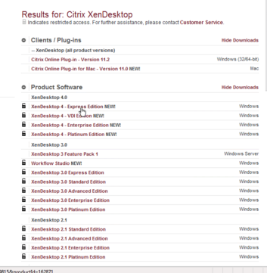
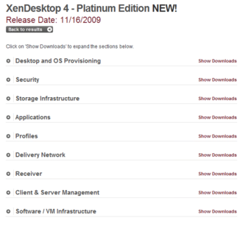
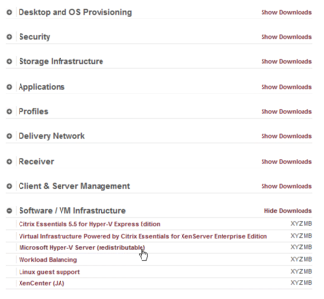
Hyper-V Server Included w/ XenDesktop 4
XenDesktop 4 expands the company’s longtime partnership with Microsoft ….. XenDesktop now ships with Hyper-V …
Bob Muglia, President, Server and Tools Business, Microsoft Corp.
Step One:
Select XenDesktop Edition
Step Two:
Select virtualization platform
Step Three:
Download Hyper-V Server

Slide 45
Citrix Essentials 5.5 for Hyper-V
Supports new ‘R2’ features of Hyper-V and System Center
Citrix Essentials for Microsoft Hyper-V
Included w/ XenDesktop 4 Enterprise
Citrix Essentials for Hyper-V extends Windows Server 2008 Hyper-V and System Center with advanced virtualization management and automation

Slide 46
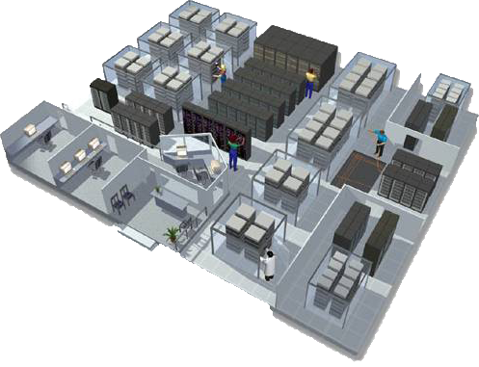
Virtualization Challenges
Image management
Lack of image management tools
Lack of business charge back mechanisms
Unable to leverage existing storage infrastructure
Storage Complexity
The “I/O blender”
Dozens of steps to configure storage for VMs
Requires coordination between server and storage groups
Can’t use intelligent storage services
Infrastructure sprawl
Need for faster testing and development cycles
Testing requirements growing more complex
Infrastructure sprawl, wasted resources
Need to track, control and share resources
Operational inefficiencies
Manual tasks introduce delay and errors
Scripting requires time & expertise
Increasing IT demands

Slide 47
Solution – Citrix Essentials for Hyper-V
Image management
Lack of image management tools
Lack of business charge back mechanisms
Unable to leverage existing storage infrastructure
Storage complexities
The “I/O blender”
Dozens of steps to configure storage for VMs
Requires coordination between server and storage groups
Can’t use intelligent storage services
Dynamic provisioning services
Advanced storage integration
Infrastructure sprawl
Need for faster testing and development cycles
Testing requirements growing more complex
Infrastructure sprawl, wasted resources
Need to track, control and share resources
Operational inefficiencies
Manual tasks introduce delay and errors
Scripting requires time & expertise
Increasing IT demands
Automated lab management
Workflow orchestration
Included w/ XenDesktop 4 Enterprise

Slide 48
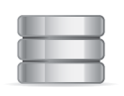
Site Recovery with StorageLink (New in 5.5)
Easy setup of array-based remote mirroring
Remote staging of Hyper-V VMs for DR testing
Automation with workflows and Microsoft Clustering
Remote Mirroring
Snapshot-based Staging/Testing
StorageLink Site Recovery
Included w/ XenDesktop 4 Enterprise

Slide 49
XenDesktop 4 expands the company’s longtime partnership with Microsoft ….. XenDesktop now ships with Hyper-V as well … simplify the management of physical and virtual desktops and applications via the Microsoft System Center management platform … including plans to further integrate solutions like Microsoft Application Virtualization (App-V) into the Citrix XenDesktop experience …
“Citrix XenDesktop 4 represents an important milestone for the industry and an ideal complement to Microsoft’s user-centric computing vision” said Bob Muglia, President, Server and Tools Business, Microsoft Corp.

Slide 50
CMVP
Notes:
Barbara Campbell
Sr. Partner Relationship Manager

Slide 51
Why Microsoft and Citrix?
Microsoft and Citrix
20+ year relationship
Customers
215,000 joint customers
99% of Fortune 1000
1M+ servers delivering apps to 100M users
10,000+ joint partners in over 100 countries
Joint technical collaboration and patent agreements
Proven track record of delivering successful joint solutions
Microsoft Windows 7 & Citrix XenDesktop
Citrix Essentials for Hyper-V
Citrix Branch Repeater with Windows Server
Microsoft RDS/Application Virtualization & Citrix XenApp
Deep collaboration on virtualization solutions from the data center to the desktop
Joint VDI support – before and after the sale
VDI showcases in MTCs
Joint Proof-of-Concept program
Cross-training for field teams
Joint VDI Partner ecosystem
Coordinated product management/ product marketing

Slide 52
CMVP Program
VDI PoC Nomination Guidance
Jointly funded program (Windows Server, Window Client, Citrix) to drive account team engagement and generate wins
US enterprise accounts with min. 500 potential VDI seats (non-US accounts by exception)
Joint VDI offering
MS: VDI Suite, Hyper-V, SCVMM, App-V
Citrix: XD on Hyper-V, Citrix Essentials on Hyper-V
Cannot be positioning any other hypervisor (e.g., ESX, XenServer, etc.)
Preference to customers willing to provide evidence and VMware compete deals
Purchase decision based primarily outcome of PoC/pilot
80 PoCs
40 Wins
6 Case Studies

Slide 53
Citrix XenDesktop 4
Conclusion

Slide 54
Microsoft VDI & XenDesktop 4 The Best Solution & The Best Value
Single solution, ultimate flexibility
Best desktop for every user
Investment leverage
End-to-end desktop virtualization
Best of Microsoft & Citrix Technologies

